Slide 1
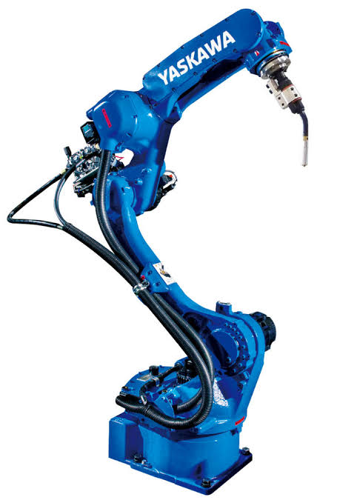
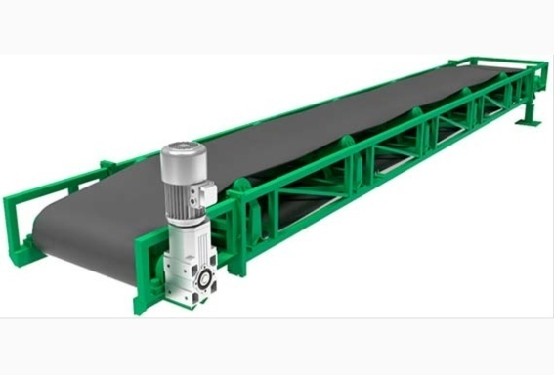
FINAL YEAR PROJECT
DESIGN ARC WELDING APPLICATION ALONG WITH CONVEYOR USING SEQUENCE PROGRAMMING
BY
ASHISH KUMAR 16A31A0364
B.BALAJI 16A31A0365
CH. PHAEENDRA RAJU 16A31A0368
S. NOOKARAJU 16A31A03A9

Slide 2
INTRODUCTION
The importance of robotics to mankind has led to intensive research for over past decades. Market demands, environmental conservation, industrial automation, and personal services are among the major factors contributing to rapid evolution in robotics application.
Industrial robot is defined by ISO as an automatically controlled, reprogrammable, multipurpose manipulator, programmable in three or more axes, which can be either fixed in place or mobile for use in industrial automation applications.

Slide 3

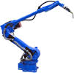
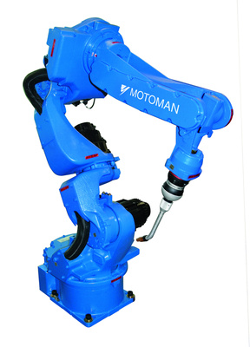
Industrial Robotics
It is an American subsidiary of the Japanese company - Yaskawa Electric Corporation.
The word “MECHATRONICS” is derived by Yaskawa Electric Corporation.
It produces robotic automation for industries which includes the following applications:
Arc welding
Assembly
Clean room
Coating
Dispensing
Material cutting
Materials handling
Spot welding
It is the second largest robotics company in the Americas.

Slide 4
THREE LAWS OF ROBOTICS
A robot may not injure a human being or, through inaction, allow a human being to come to harm.
A robot must obey the orders given to it by human beings, except where such orders would conflict with the First Law.
A robot must protect its own existence as long as such protection does not conflict with the First or Second Law.

Slide 5
Robot parameters
Degrees of freedom – This is usually the same as the number of axes.
Working envelope – The region of space a robot can reach.
Kinematics – The actual arrangement of rigid members and joints in the robot.
payload – How much weight a robot can lift.
Speed – How fast the robot can position the end of its arm.
Acceleration – How quickly an axis can accelerate
Accuracy – How closely a robot can reach a commanded position
Repeatability – How well the robot will return to a programmed position.
Compliance - Measure of the amount in angle or distance that a robot axis will move when a force is applied to it.

Slide 6
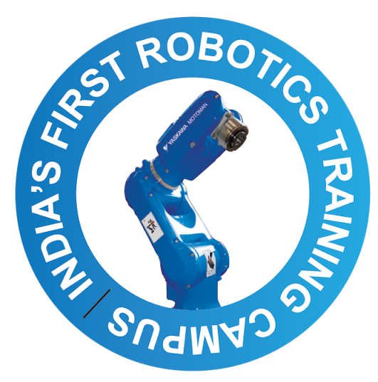
ROBOT ANATOMY
CONTROLLER
MANIPULATOR
END EFFECTOR
DRIVE
SENSORS

Slide 7
Industrial Robotics Timeline
1954
1960
1962
1973
1974
1975
1977
1st Industrial Robot
Unimate
Silver Arm
Motoman L10
First Industrial Robot used by a major manufacturer – General Motors
Developed by Victor Scheinman.
Used for Small part assembly jobs.
Introduced by George Devol, used for transferring objects.
Yaskawa’s first Industrial robot with 5 axes.
Versatran
Famulus
ASEA IRB
Designed by Harry Johnson & Veljko Milenkovic
Designed by KUKA.
Worlds first 6 Axis Robot
World’s first fully electrically driven robot.

Slide 8
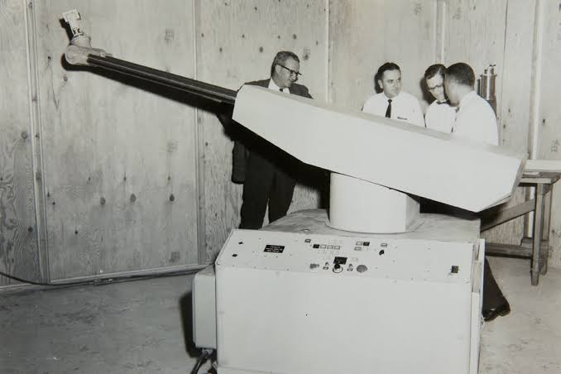
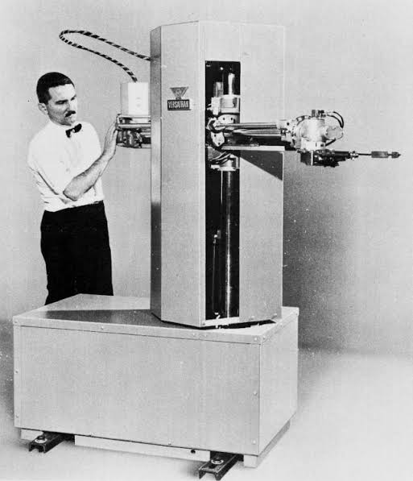
1st Industrial Robot:
Introduced by George Devol
Used for transporting die castings
VERSATRAN:
World’s first cylindrical robot
First Commercial Painting robot
First Commercial robot used in Ford Motors

Slide 9
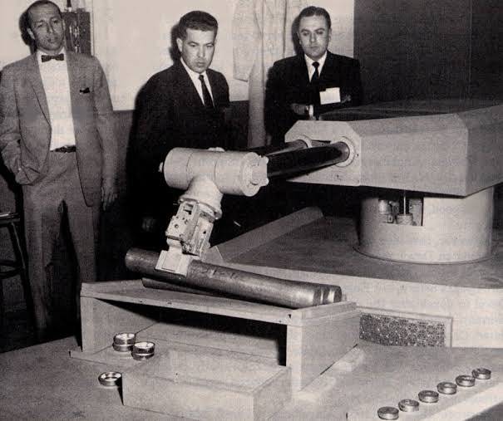
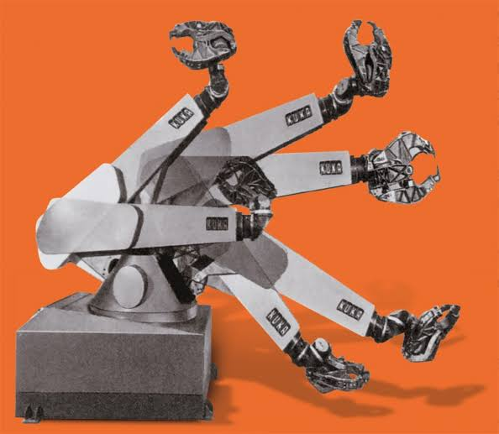
UNIMATE:
World’s first commercial Pick and Place robot
First installed in General Motors for Transferring the jobs and performing welding applications
FAMULUS:
Designed and developed by KUKA
World’s first electro-mechanically driven 6 axis robot.

Slide 10
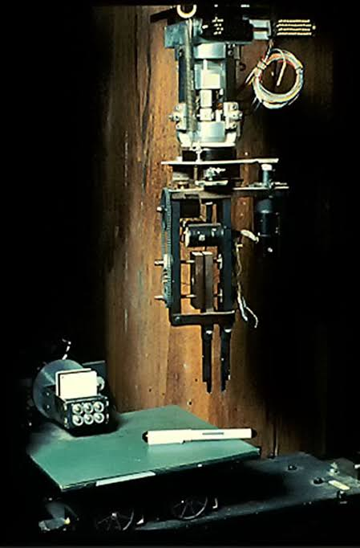
SILVER ARM:
World’s first robotic arm installed with sensors
Robotic gripper included touch and pressure sensors which are used as feedback for assembling small parts

Slide 11
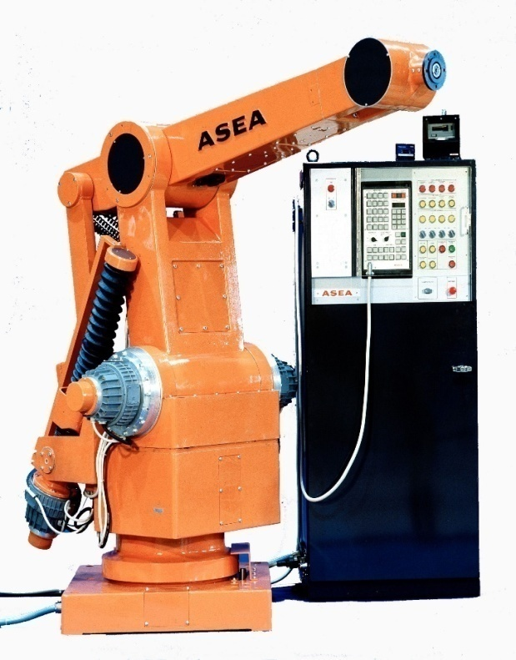
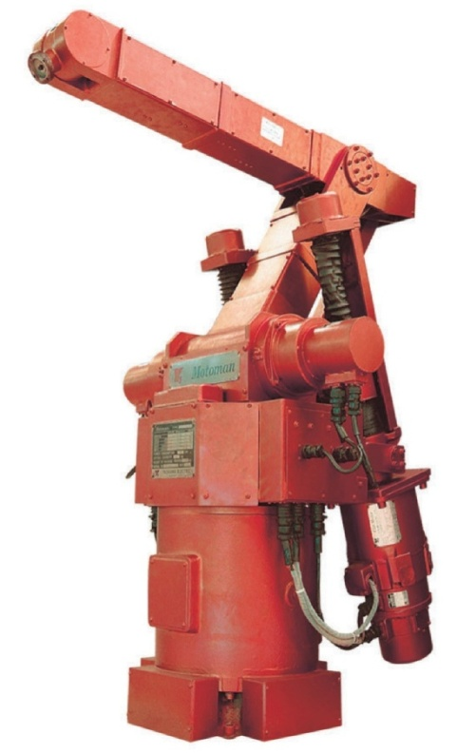
ASEA IRB:
World’s first fully Electrically driven robot.
First micro-processor controlled robot and also the first in world to use intel chipset.
MOTOMAN L10:
First robot developed by Yaskawa.
With 5 axes it can lift a weight of 10 kg.

Slide 12
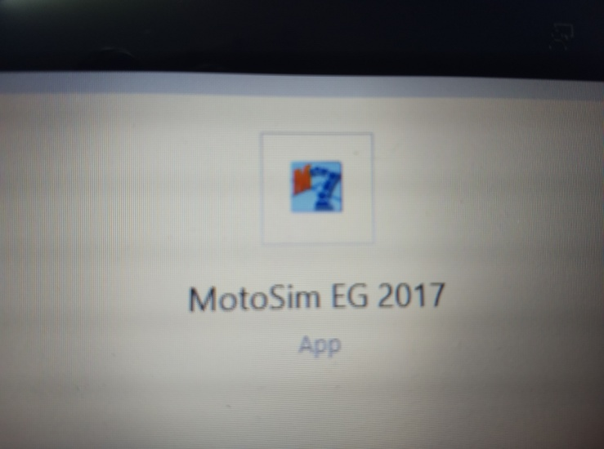
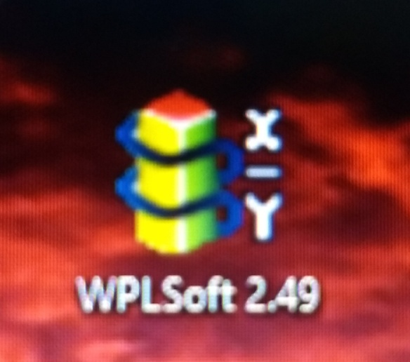
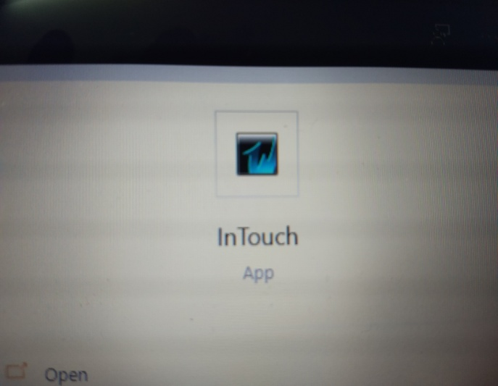
PROJECT DESCRIPTION
The Project is based on the design Arc welding Application along with conveyor by using MOTOSIM EG 2017 software which is used to control the action of Robot along with WPLSoft2.49 software which controls the action of PLC’s along with that the SCADA Program will Controls all the robot working and PLC’s action through the SCADA program using Wonderware Intouch Software.

Slide 13
MOTOSIM EG SOFTWARE
MotoSim EG (Motoman Simulator Enhanced Graphics) is a comprehensive software package that provides accurate 3D simulation of robot cells. This powerful simulation software can be used to optimize robot and equipment placement, as well as to perform collision detection reach molding ad cycle calculation. It also provides accurate offline programming of complex system. In this software we teach multiple robots for arc welding process by adding conveyor belt ad 3d object.

Slide 14
MOTOMAN UNIQUENESS
MOTOMAN has done many robotic innovations which are first in the world –
To develop patented design arc welding robot with built in cables on upper arm.
Dual arm 15 axis humanoid robot.
7- Axis type robot
Fastest welding robots.
World’s first 7-axis arc welding and spot welding robot.
The first successful ultrasonic cutting robot.

Slide 15
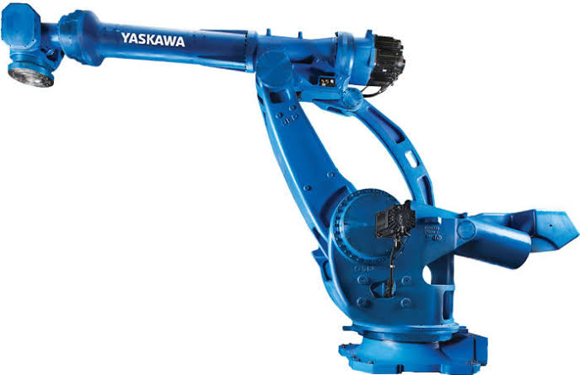
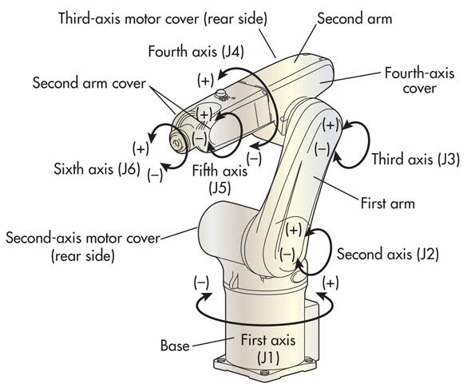
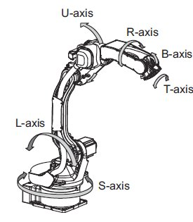
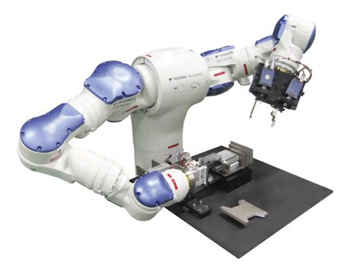
MOTOMAN Specification
Maximum payload: 900kg
Maximum Vertical reach: 6209mm
Maximum Horizontal reach: 4683mm
Maximum axis: 15 axis
Maximum mass: 9550kg
Motoman: S (Axis 1)
Motoman: L (Axis 2)
Motoman: U (Axis 3)
Motoman: R (Axis 4)
Motoman: B (Axis 5)
Motoman: T (Axis 6)
ROBOT AXIS
ARTICULATED ROBOT

Slide 16
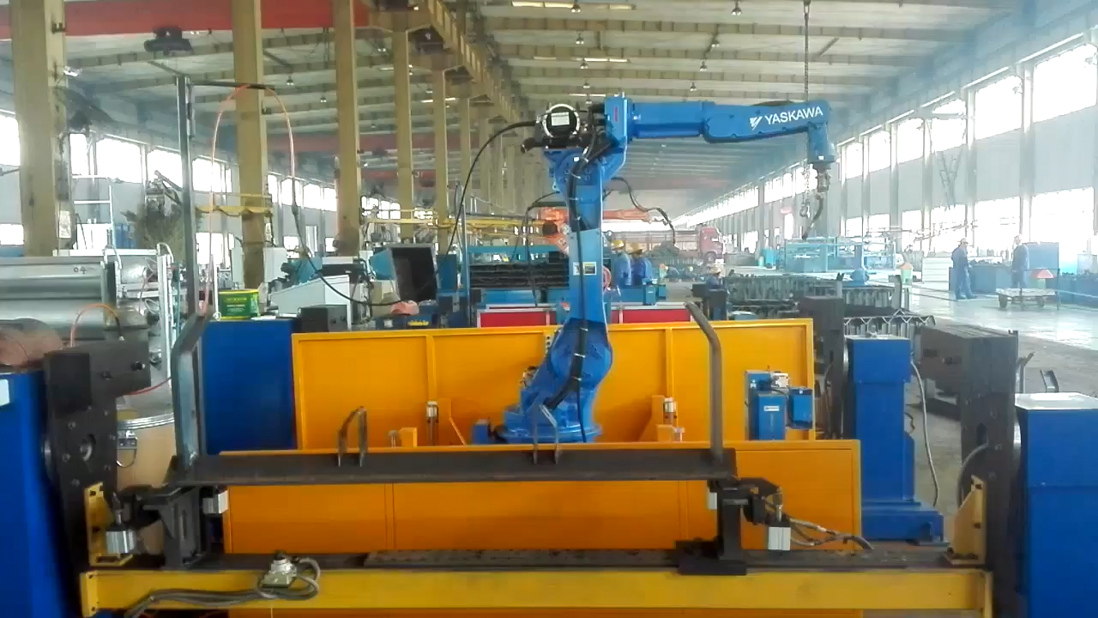

Slide 17


Slide 18
PROGRAMMABLE LOGIC CONTROLLER(PLC)
A Programmable Logic Controller (PLC) is a small, self–contained, rugged computer designed to control processes and events in an industrial environment – that is, to take over the job previously done with relay logic controllers. Wires from switches, sensors and other input devices are attached directly to PLC. Each PLC contains a microprocessor that has been programmed to drive the output (O/P). Terminals in specified manner, based on the signals from the input terminals. The PLC program is usually developed on the separate programmer (PG) computer such as a Personal Computer (PC), using special software provided by the PLC manufacturer.
Once the program has been written, it is transferred or downloaded into the PLC.

Slide 19
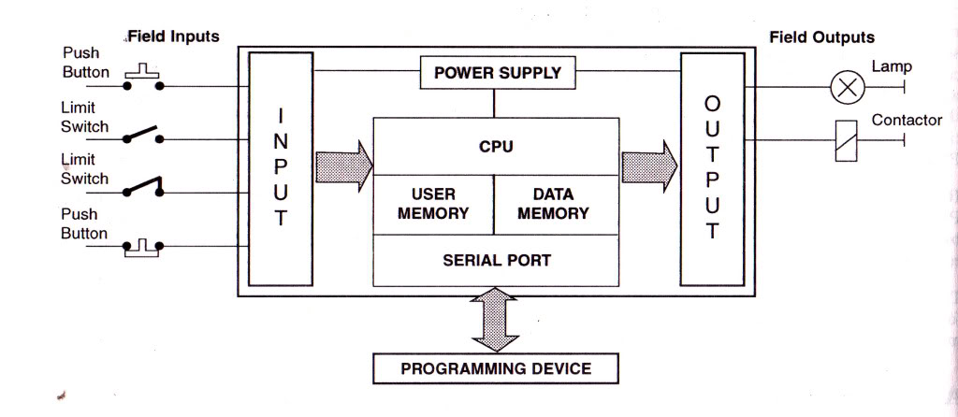

Slide 20
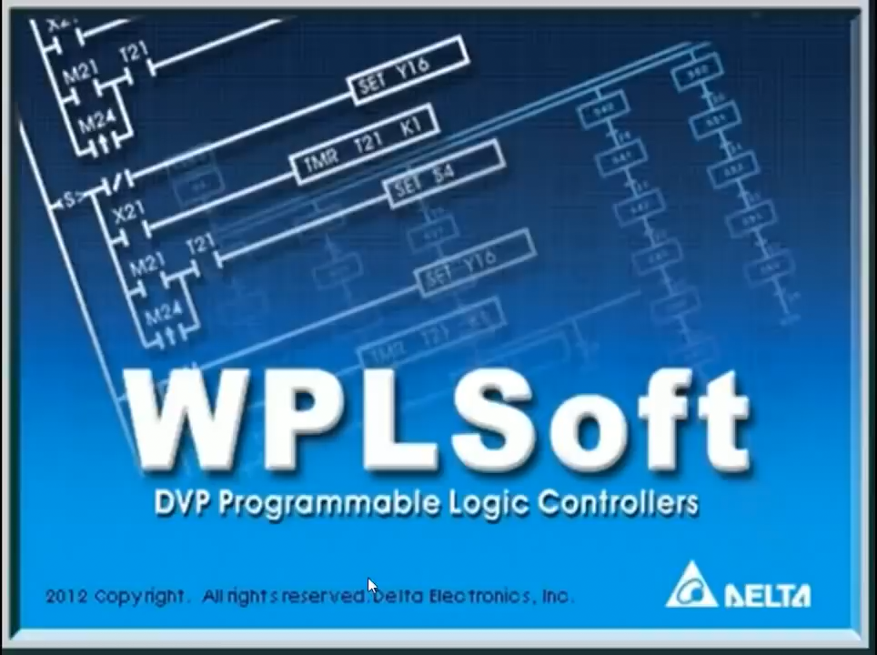

Slide 21
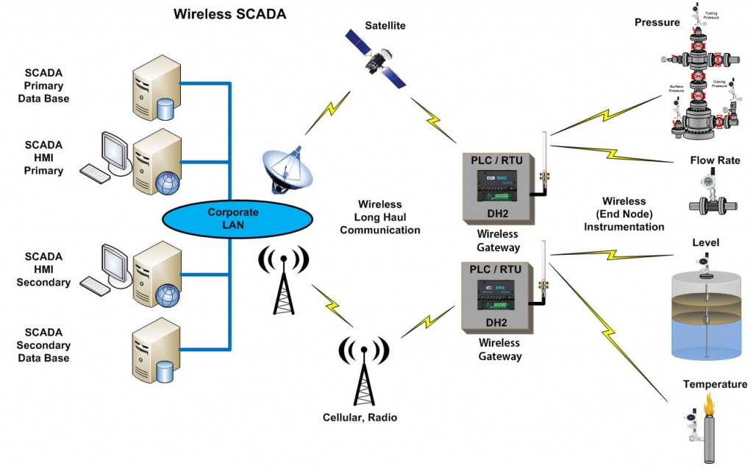
SUPERVISORY CONTROL AND DATA ACQUISITION
(SCADA)
Supervisory control and data acquisition (SCADA) is a system for remote monitoring and control that operates with coded signals over communication channels.(using typically one communication channel per remote station).
SCADA is purely a 100% software which is nothing but application development of the real-time industry with animation representation.
Addresses in SCADA is represented as “tag names”.
Evaluating a process seconds by seconds can be done.

Slide 22
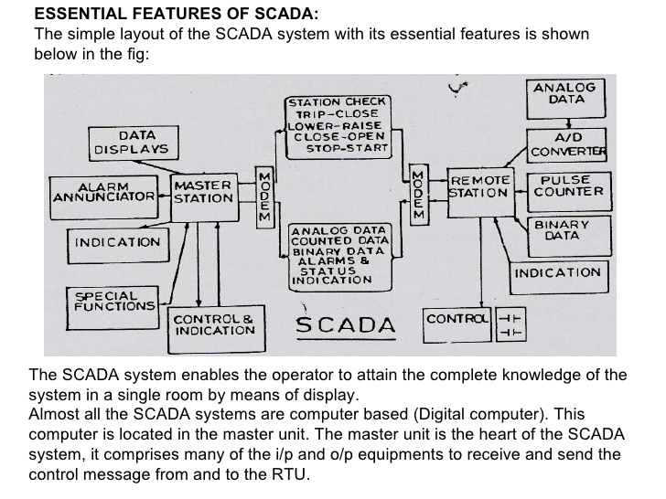

Slide 23
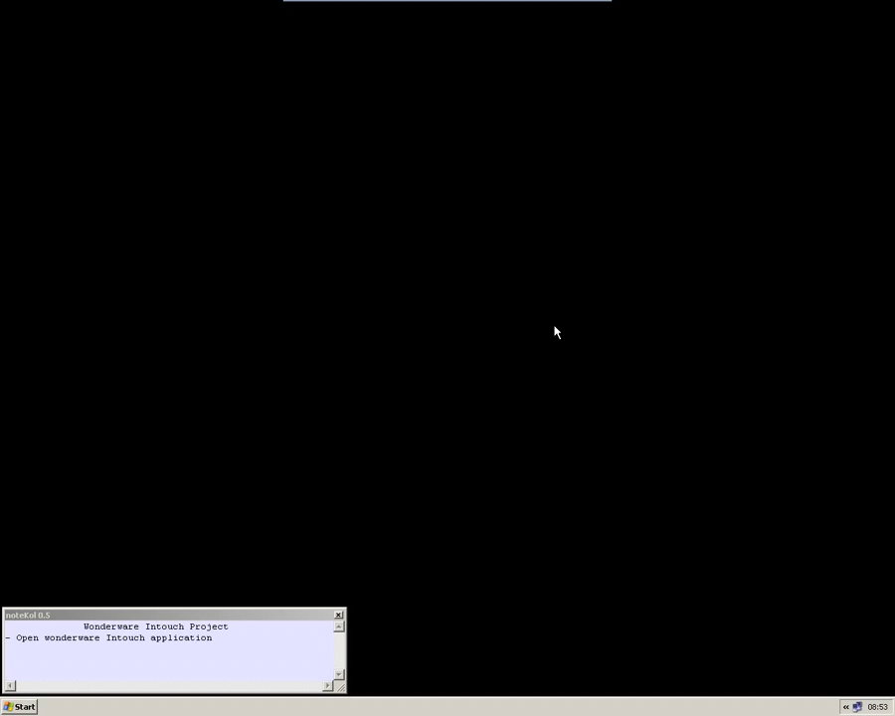

Slide 24
END
THANK YOU

